Slide 1



Attendance System in c++
Mehran University of engineering and
technology
Submitted by
Syed Muhammad Qasim (24bsai029)
Muhammad Sadiq qazi (24bsai033)
Syed Muhammad Shaheer ali (24bsai052)
Muhammad Safeer (24bsai022)

Slide 2

Introduction
The Attendance system is console based project Developed using C++ language . This program can record attendance of class quickly and accurately. This program Show Roll numbers of whole class one by one automatically and allow user to mark them as present or absent, once user done marking the program will show summary of attendance displaying total present and absent students alongside of their roll numbers. This program is designed to save time, reduce errors, and showcase the practical use of loops, arrays, and input validation in C++.

Slide 3
Program features
Allow user to enter current date for record-keeping
Generates roll numbers (24BSAI01 to 24BSAI56).
Input attendance as 'p' (present) or 'a' (absent).
Ensures only 'p' or 'a' is accepted as input.
Displays total counts and lists of present and absent students.

Slide 4


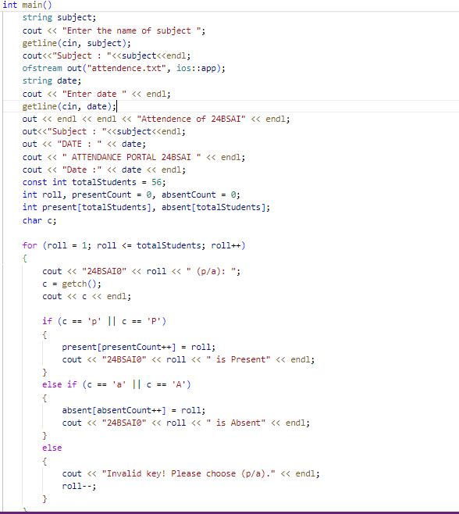

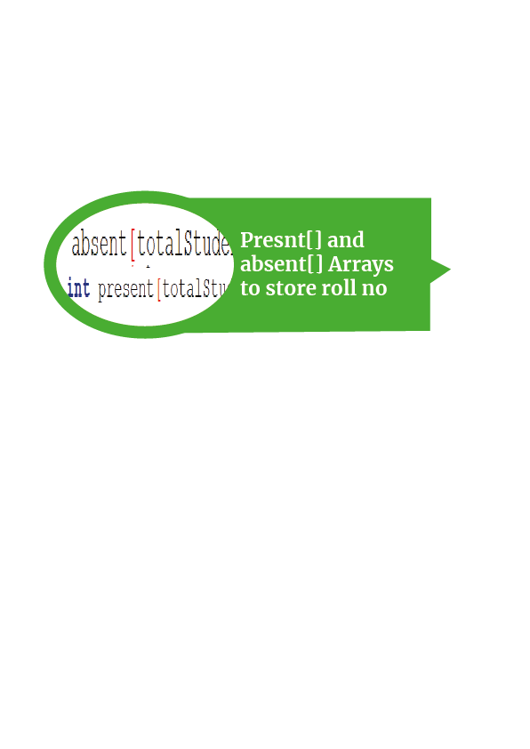
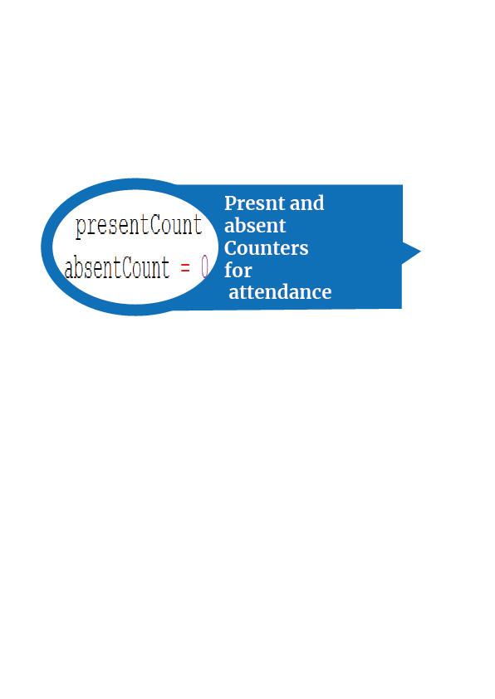
Code breakdown
– headers and variables
This program contain many variable some important of them are discussed below with header files

Slide 5
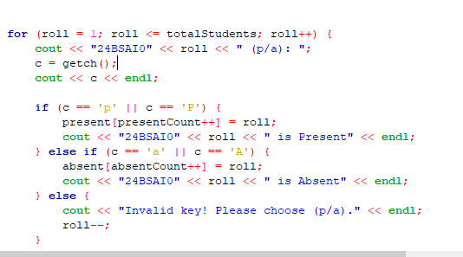
Code breakdown –attendance input
How Attendance Input Works:
The program uses a loop to go through each roll number, from 1 to 56.
For every student, it asks the user to mark attendance as 'p' (present) or 'a' (absent) using the getch() function.
Roll numbers of present students are added to the present array.
Roll numbers of absent students are added to the absent array.
If the input is invalid (anything other than 'p' or 'a'), the program asks for re-entry without moving to the next roll number.
Key Point: The program ensures input validation, making it impossible to skip or enter incorrect attendance entries. This keeps the attendance data accurate and reliable.

Slide 6
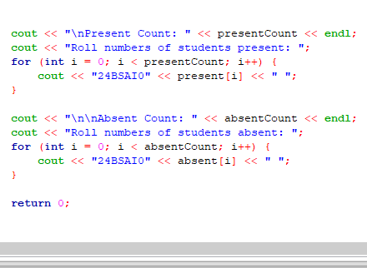
Code breakdown- Attendance summary
How Attendance Summary Works:
After attendance is recorded, the program shows the total number of students who are present and absent.
It also lists the roll numbers of all present and absent students.
How It’s Done in Code:
Two separate for loops are used:
One loop goes through the present array to print roll numbers of students marked present.
The other loop goes through the absent array to print roll numbers of students marked absent.

Slide 7
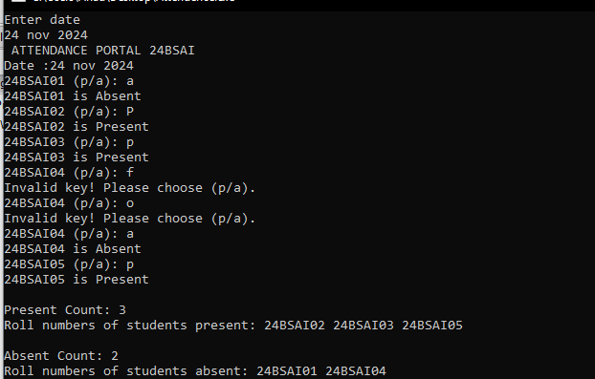
Brief demo Output (For only five roll numbers)

Slide 8
Scope for improvement
Add a Graphical Interface: Replace the text-based console with a user-friendly graphical UI to make it easier to use.
Allow Dynamic Class Sizes: Let users enter the total number of students instead of using a fixed number, making the program more flexible.

Slide 9
Conclusion
This program showcases how loops, arrays, and conditional statements can be used in C++ to solve practical problems like attendance tracking. The program is simple, easy to use, and demonstrates the importance of structured programming. While it works well for its current purpose, there is also room for improvement, making it a strong foundation for building more advanced and user-friendly solutions in the future.

Slide 10
Thank you for attention
Submitted to:
Ma’am. Fahama barkzai
Subject:
Programming Fundamentals

